Slide 1
An IP address is a
32-bit
address.
The address space of IPv4 is
2³²
or
4,294,967,296.

Slide 2
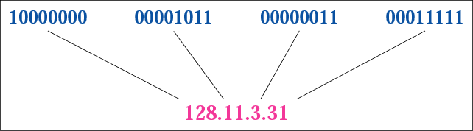
Figure 4-1
Dotted-decimal notation

Slide 3
Example 3
Find the error, if any, in the following IP address:
111.56.045.78
Solution
There are no leading zeroes in
dotted-decimal notation (045).

Slide 4
Example 3 (continued)
Find the error, if any, in the following IP address:
75.45.301.14
Solution
In dotted-decimal notation,
each number is less than or
equal to 255; 301 is outside this range.

Slide 5
CLASSFUL
ADDRESSING

Slide 6
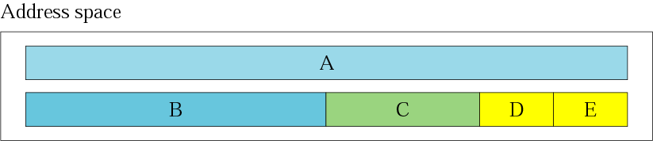
Figure 4-2
Occupation of the address space

Slide 7

In classful addressing,
the address space is
divided into five classes:
A, B, C, D, and E.

Slide 8
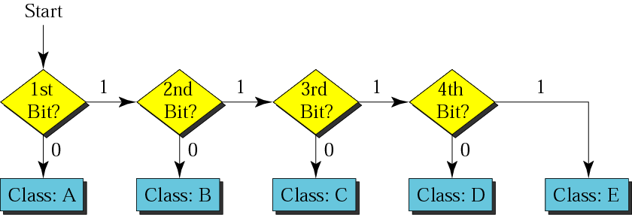
Figure 4-4
Finding the address class

Slide 9

Figure 19.2 Finding the classes in binary and dotted-decimal notation

Slide 10
Example 19.4
Find the class of each address.
a. 00000001 00001011 00001011 11101111
b. 11000001 10000011 00011011 11111111
c. 14.23.120.8
d. 252.5.15.111
Solution
a. The first bit is 0. This is a class A address.
b. The first 2 bits are 1; the third bit is 0. This is a class C
address.
c. The first byte is 14; the class is A.
d. The first byte is 252; the class is E.

Slide 11
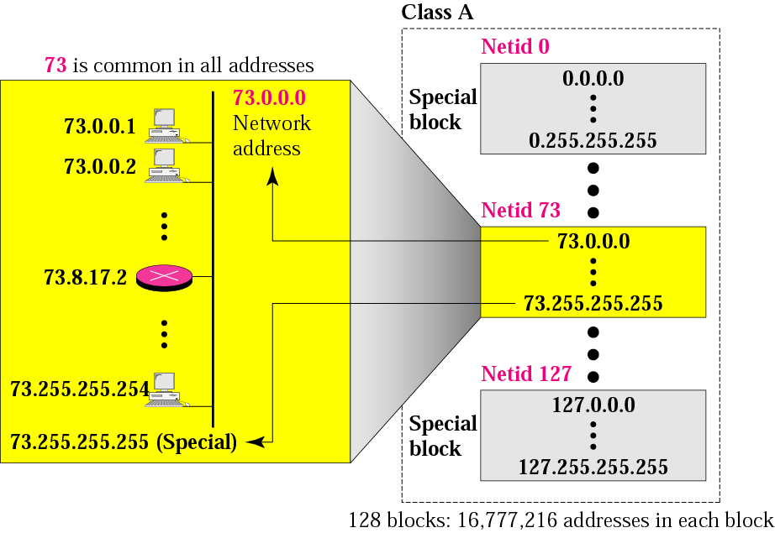
Figure 4-7
Blocks in class A

Slide 12
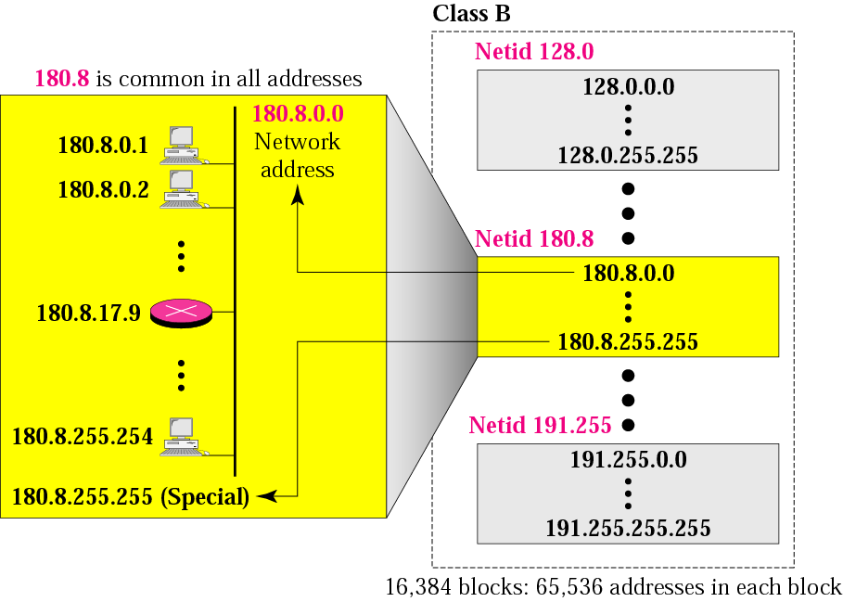
Figure 4-8
Blocks in class B

Slide 13
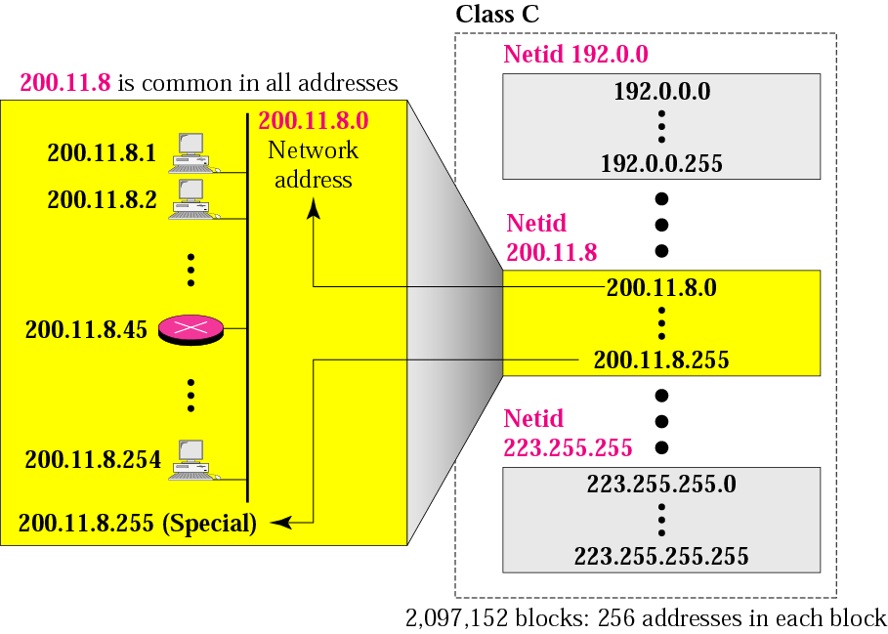
Figure 4-9
Blocks in class C

Slide 14

Table 19.1 Number of blocks and block size in classful IPv4 addressing

Slide 15

Table 19.2 Default masks for classful addressing

Slide 16

Figure 19.3 A block of 16 addresses granted to a small organization

Slide 17
Example 19.5
Figure 19.3 shows a block of addresses, in both binary and dotted-decimal notation, granted to a small business that needs 16 addresses.
We can see that the restrictions are applied to this block. The addresses are contiguous. The number of addresses is a power of 2 (16 = 2⁴), and the first address is divisible by 16. The first address, when converted to a decimal number, is 3,440,387,360, which when divided by 16 results in 215,024,210.

Slide 18

Note
In IPv4 addressing, a block of
addresses can be defined as
x.y.z.t /n
in which x.y.z.t defines one of the addresses and the /n defines the mask.

Slide 19
Note
The first address in the block can be found by setting the rightmost
32 − n bits to 0s.

Slide 20
Example 19.6
A block of addresses is granted to a small organization. We know that one of the addresses is 205.16.37.39/28. What is the first address in the block?
Solution
The binary representation of the given address is
11001101 00010000 00100101 00100111
If we set 32−28 rightmost bits to 0, we get
11001101 00010000 00100101 0010000
or
205.16.37.32.
This is actually the block shown in Figure 19.3.

Slide 21
Note
The last address in the block can be found by setting the rightmost
32 − n bits to 1s.

Slide 22
Example 19.7
Find the last address for the block in Example 19.6.
Solution
The binary representation of the given address is
11001101 00010000 00100101 00100111
If we set 32 − 28 rightmost bits to 1, we get
11001101 00010000 00100101 00101111
or
205.16.37.47
This is actually the block shown in Figure 19.3.

Slide 23
Note
The number of addresses in the block can be found by using the formula
2^{32−n}.

Slide 24
Example 19.8
Find the number of addresses in Example 19.6.
Solution
The value of n is 28, which means that number
of addresses is 2 ³²⁻²⁸ or 16.

Slide 25
Example 19.9
Another way to find the first address, the last address, and the number of addresses is to represent the mask as a 32-bit binary (or 8-digit hexadecimal) number. This is particularly useful when we are writing a program to find these pieces of information. In Example 19.5 the /28 can be represented as
11111111 11111111 11111111 11110000
(twenty-eight 1s and four 0s).
Find
a. The first address
b. The last address
c. The number of addresses.

Slide 26

Example 19.9 (continued)
Solution
a. The first address can be found by ANDing the given
addresses with the mask. ANDing here is done bit by
bit. The result of ANDing 2 bits is 1 if both bits are 1s;
the result is 0 otherwise.

Slide 27

Example 19.9 (continued)
b. The last address can be found by ORing the given
addresses with the complement of the mask. ORing
here is done bit by bit. The result of ORing 2 bits is 0 if
both bits are 0s; the result is 1 otherwise. The
complement of a number is found by changing each 1
to 0 and each 0 to 1.

Slide 28
Example 19.9 (continued)
c. The number of addresses can be found by
complementing the mask, interpreting it as a decimal
number, and adding 1 to it.

Slide 29
Figure 19.4 A network configuration for the block 205.16.37.32/28

Slide 30
Note
The first address in a block is
normally not assigned to any device;
it is used as the network address that represents the organization
to the rest of the world.

Slide 31

Figure 19.5 Two levels of hierarchy in an IPv4 address

Slide 32

Figure 19.6 A frame in a character-oriented protocol

Slide 33
Note
Each address in the block can be considered as a two-level
hierarchical structure:
the leftmost n bits (prefix) define
the network;
the rightmost 32 − n bits define
the host.

Slide 34

Figure 19.7 Configuration and addresses in a subnetted network

Slide 35
Example 19.10
An ISP is granted a block of addresses starting with 190.100.0.0/16 (65,536 addresses). The ISP needs to distribute these addresses to three groups of customers as follows:
a. The first group has 64 customers; each needs 256
addresses.
b. The second group has 128 customers; each needs 128
addresses.
c. The third group has 128 customers; each needs 64
addresses.
Design the subblocks and find out how many addresses are still available after these allocations.

Slide 36

Figure 19.9 An example of address allocation and distribution by an ISP

Slide 37

Example 19.10 (continued)
Solution
Figure 19.9 shows the situation.
Group 1
For this group, each customer needs 256 addresses. This means that 8 (log2 256) bits are needed to define each host. The prefix length is then 32 − 8 = 24. The addresses are

Slide 38

Example 19.10 (continued)
Group 2
For this group, each customer needs 128 addresses. This means that 7 (log2 128) bits are needed to define each host. The prefix length is then 32 − 7 = 25. The addresses are

Slide 39

Example 19.10 (continued)
Group 3
For this group, each customer needs 64 addresses. This means that 6 (log₂64) bits are needed to each host. The prefix length is then 32 − 6 = 26. The addresses are
Number of granted addresses to the ISP: 65,536
Number of allocated addresses by the ISP: 40,960
Number of available addresses: 24,576

Slide 40

Table 19.3 Addresses for private networks

Slide 41

Figure 19.10 A NAT implementation

Slide 42

Figure 19.11 Addresses in a NAT

Slide 43

Figure 19.12 NAT address translation

Slide 44

Table 19.4 Five-column translation table

Slide 45
Inefficiency of IP address

Slide 46
The IP addressing are design to work with stationary hosts because the part of address defines the network to which the host is attached. (Mobile IP)
IP address has no error reporting or error correcting mechanism. (ICMP)
No feedback if something goes wrong like – router must discard datagram if it can not find the destination host, TTL is zero, destination host must discard all fragments of datagram because it has not received all fragments within predefine time limit etc. (ICMP)
The IP address does not have a provision for host and management queries (ICMP)

Slide 47
ICMP (Internet Control Message Protocol)

Slide 48
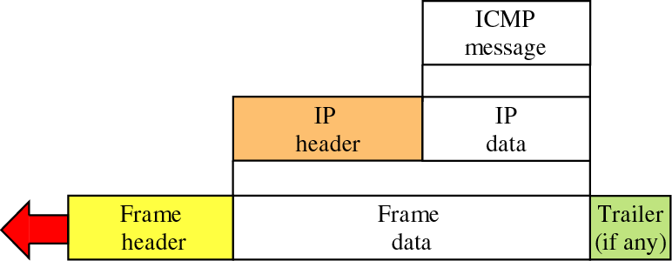
Encapsulation of ICMP packet

Slide 49
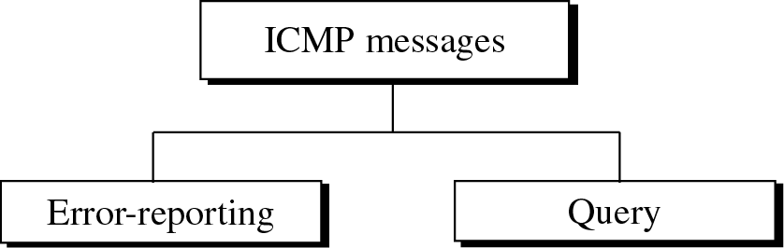
ICMP messages

Slide 50
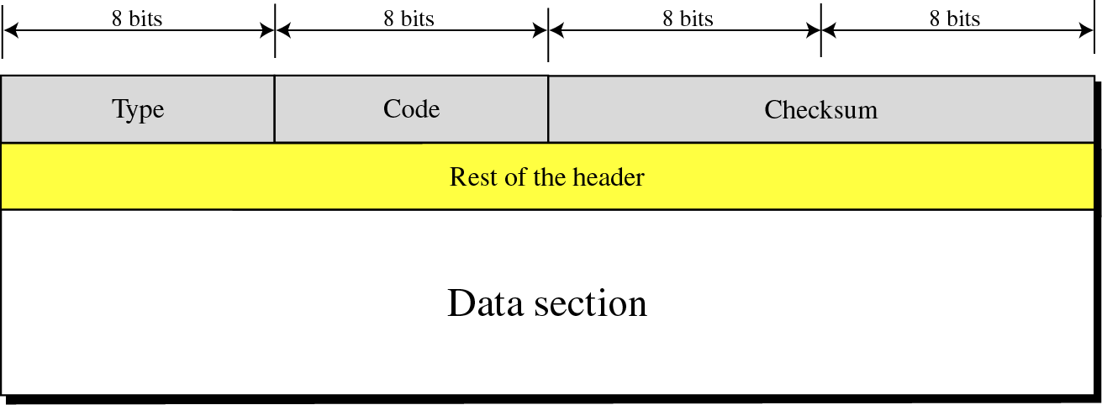
General format of ICMP messages

Slide 51
ICMP always reports
error messages
to the original source.

Slide 52
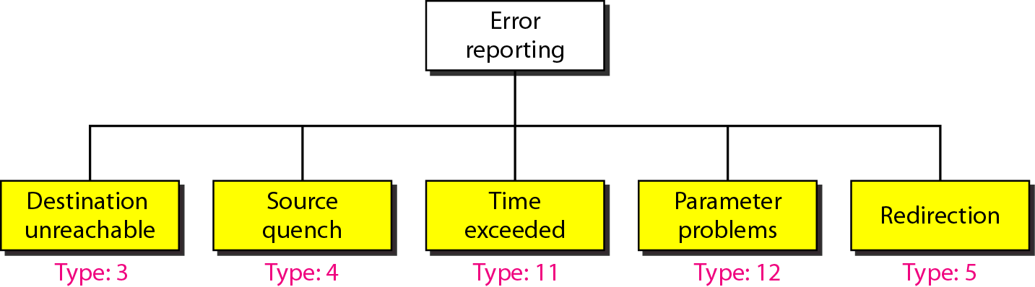
Error-reporting messages
3
4
11
12
5

Slide 53
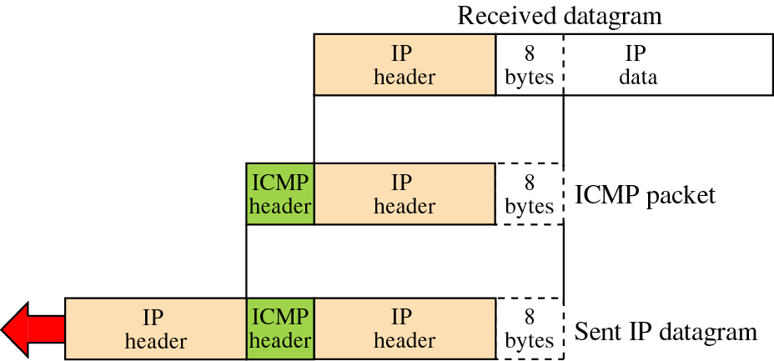
Contents of data field for error messages
Original source IP
header
Port no. & Seq. no. for TCP and UDP

Slide 54
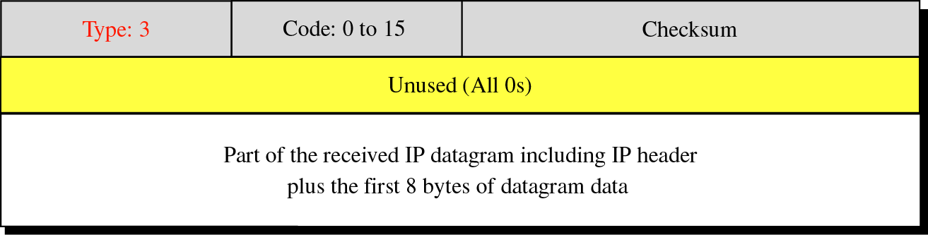
Destination-unreachable format

Slide 55
Code | Description
0 | Network is unreachable, due to hardware failure
1 | Host is unreachable, due to hardware failure
2 | Protocol is unreachable. TCP/ UDP
3 | Port is unreachable
4 | Fragmentation is required
5 | Source routing can not be accomplished
6 | Destination network is unknown
7 | Destination host is unknown
8 | Source host is isolated
9 | Communication with destination network is administratively prohibited
10 | Communication with destination host is administratively prohibited
11 | Network is unreachable
12 | Host is unreachable
13 | Host is unreachable because administrator has put a filter on it
14 | Host is unreachable because host precedence is violated
15 | Host is unreachable because host precedence is cut off

Slide 56
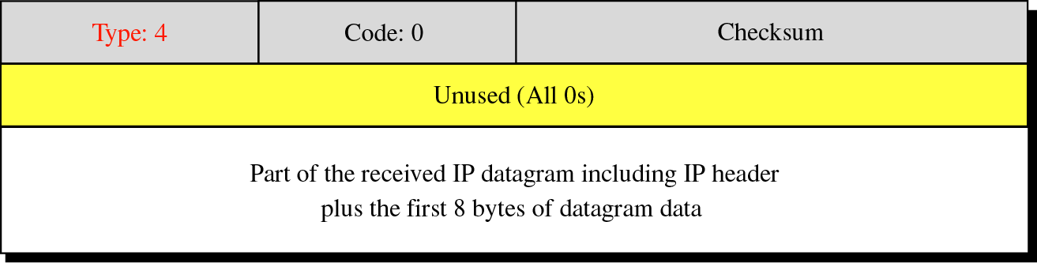
Source-quench format
Flow control and congestion control

Slide 57
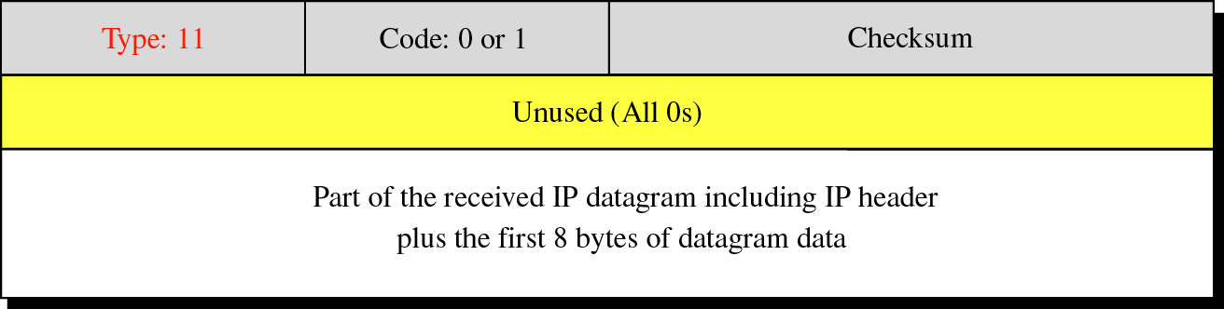
Time-exceeded message format
Code 0: Time to live
Code 1: Fragmentation

Slide 58
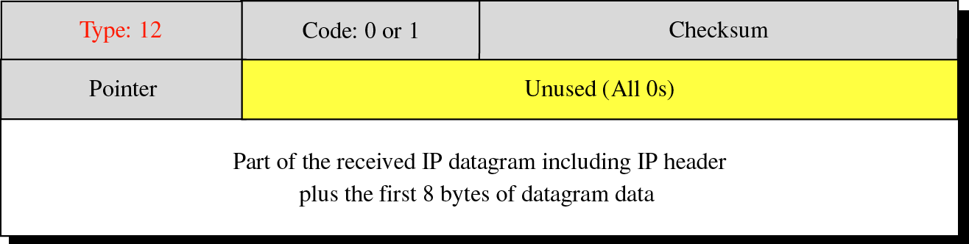
Parameter-problem message format
Code 0: Main header problem
Code 1: Problem in the option field
Can be created by router or host

Slide 59
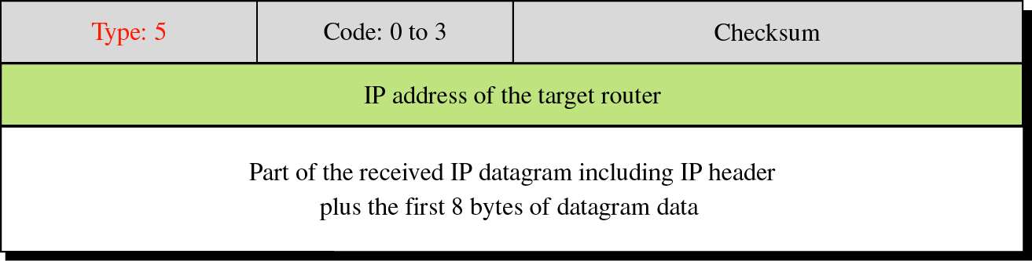
Redirection message format
Code 0: Network specific
Code 1: Host specific
Code 2: Network specific (specified service)
Code 3: Host specific (specified service)

Slide 60
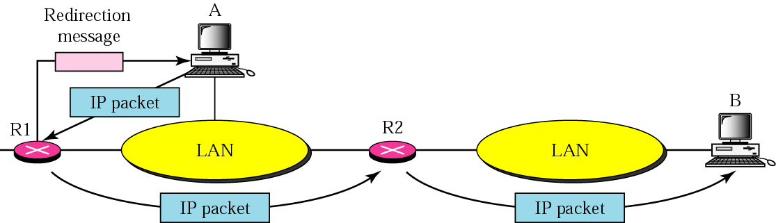
Redirection concept

Slide 61

Query messages

Slide 62
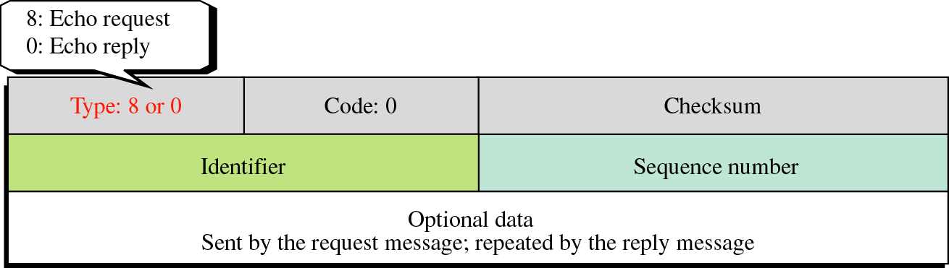
Echo-request and echo-reply message format
Ping command can use
theses messages.

Slide 63
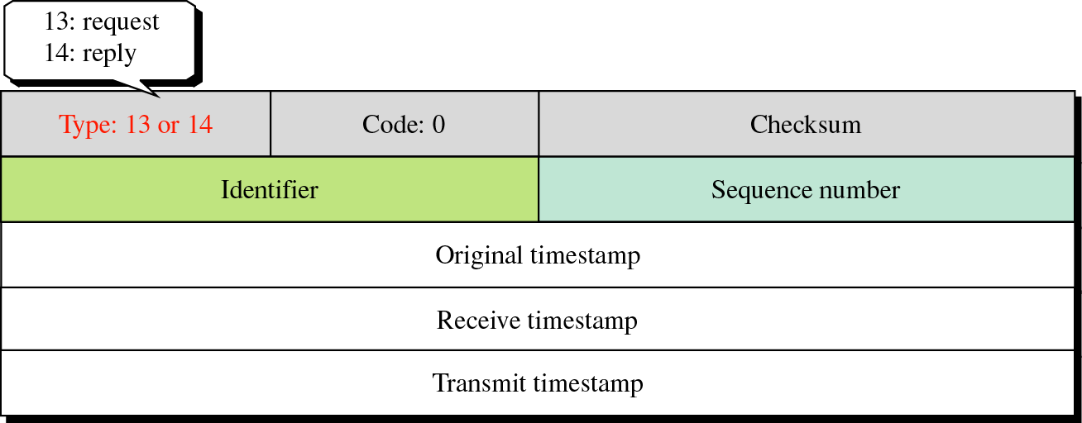
Timestamp-request and
timestamp-reply message format

Slide 64
Echo-request and echo-reply messages
can test the
reach ability of a host.
This is usually done by
invoking the ping command.

